Slide 1

Types of Data and Data Models
CAP 5738 Data Visualization
Spring 2018
Dr. Sayeed S. Alam

Slide 2
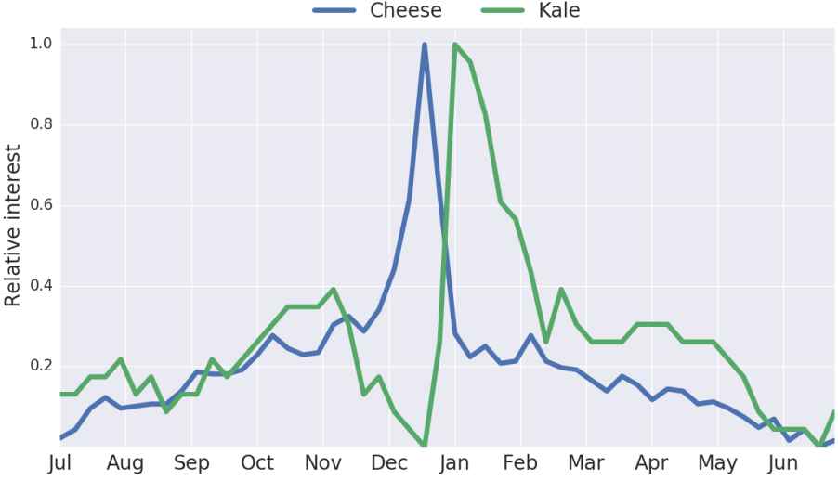
Today’s Visualization
Average search interest in "cheese" and "kale" in the UK with time (Python with Google Trends)

Slide 3
Types of Data
Data
Entities
Attributes
Example:
Profile={
Name = ‘JonSnow’,
KnowsNothing = ‘True’
Sword =‘Long Claw’
isBastard = ‘True’
Age = 22
}

Slide 4
Data Type Hierarchy
Data
Quantitative
Qualitative
Continuous
Discrete

Slide 5
Attribute Quality
Nominal : This is the labeling function. Fruit can be classified into apples, oranges, bananas, and so on. There is no sense in which the fruit can be placed in an ordered sequence. Sometimes numbers are used in this way. Thus, the number on the front of a bus generally has a purely nominal value. It identifies the route on which the bus travels.
Ordinal: The ordinal category encompasses numbers used for ordering things in a sequence. It is possible to say that a certain item comes before or after another item. The position of an item in a queue or list is an ordinal quality. When we ask people to rank some group of things (films, political candidates, computers) in order of preference, we are requiring them to create an ordinal scale.

Slide 6
Attribute Quality
Interval: When we have an interval scale of measurement, it becomes possible to derive the gap between data values. The time of departure and the time of arrival of an aircraft are defined on an interval scale.
Ratio: With a ratio scale, we have the full expressive power of a real number. We can make statements such as “Object A is twice as large as object B.” The mass of an object is defined on a ratio scale. Money is defined on a ratio scale. The use of a ratio scale implies a zero value used as a reference

Slide 7
Data Type Hierarchy
Data
Quantitative
Qualitative
Nominal
Ordinal
Binary
Continuous
Discrete
Interval
Ratio
Nominal
Ordinal
Binary

Slide 8
Examples
Nominal : Apples, Oranges, Panther Id
Ordinal: Age, Level of Pain
Binary: Male/Female
Interval: Class interval
Ratio: two times bigger

Slide 9
Data Models
Flat Model: Tables/ Matrices with rows and columns
Hierarchical Model: Tree type network connection
Network Model: One-to many connections
Relational Model: one-to-one/ one-to-many / many-to-many connections.
Object-Relational Model: Supports inheritance

Slide 10
Popular Data Formats
XML: Extensible Markup Language
JSON: Java Script Object Notation

Slide 11
XML
Title | Author
Everyday Italian | Giada De Laurentiis
Harry Potter | J K. Rowling
XQuery Kick Start | James McGovern
Learning XML | Erik T. Ray

Slide 12
XML
<?xml version="1.0" encoding="UTF-8"?> <bookstore> <book category="cooking"> <title lang="en">Everyday Italian</title> <author>Giada De Laurentiis</author> <year>2005</year> <price>30.00</price> </book> <book category="children"> <title lang="en">Harry Potter</title> <author>J K. Rowling</author> <year>2005</year> <price>29.99</price> </book>
… </bookstore>

Slide 13
XML
XML: Elements, Attributes
<title lang="en">Everyday Italian</title>
Element: title
Text: Everyday Italian
Attribute name = lang
Attribute value = en
No explicit data types

Slide 14
JSON
{type :”bookstore”,
Books : [
{type: “Book”, title: “Everyday Italian”, Price: 30.0},
{type : “Book”, title: “Harry Potter”, Price: 30.0},
…
]
}
Supports data types: string, number, object, array, Boolean, null

Slide 15
Thank You

